Slide 1

QSolve Quantum Hackathon
Quantum-Optimized Portfolio Building for East African Pension & SACCO Funds
FINTECH GROUP 2
SDG 8 — DECENT WORK & ECONOMIC GROWTH

Slide 2

The Core Research Question
Can quantum optimization help East African pension and SACCO funds construct diversified investment portfolios more efficiently under realistic constraints, while maintaining or improving risk-adjusted returns compared with classical methods?
The key is not to claim quantum advantage beforehand — the project should test whether a quantum approach can provide one.

Slide 3
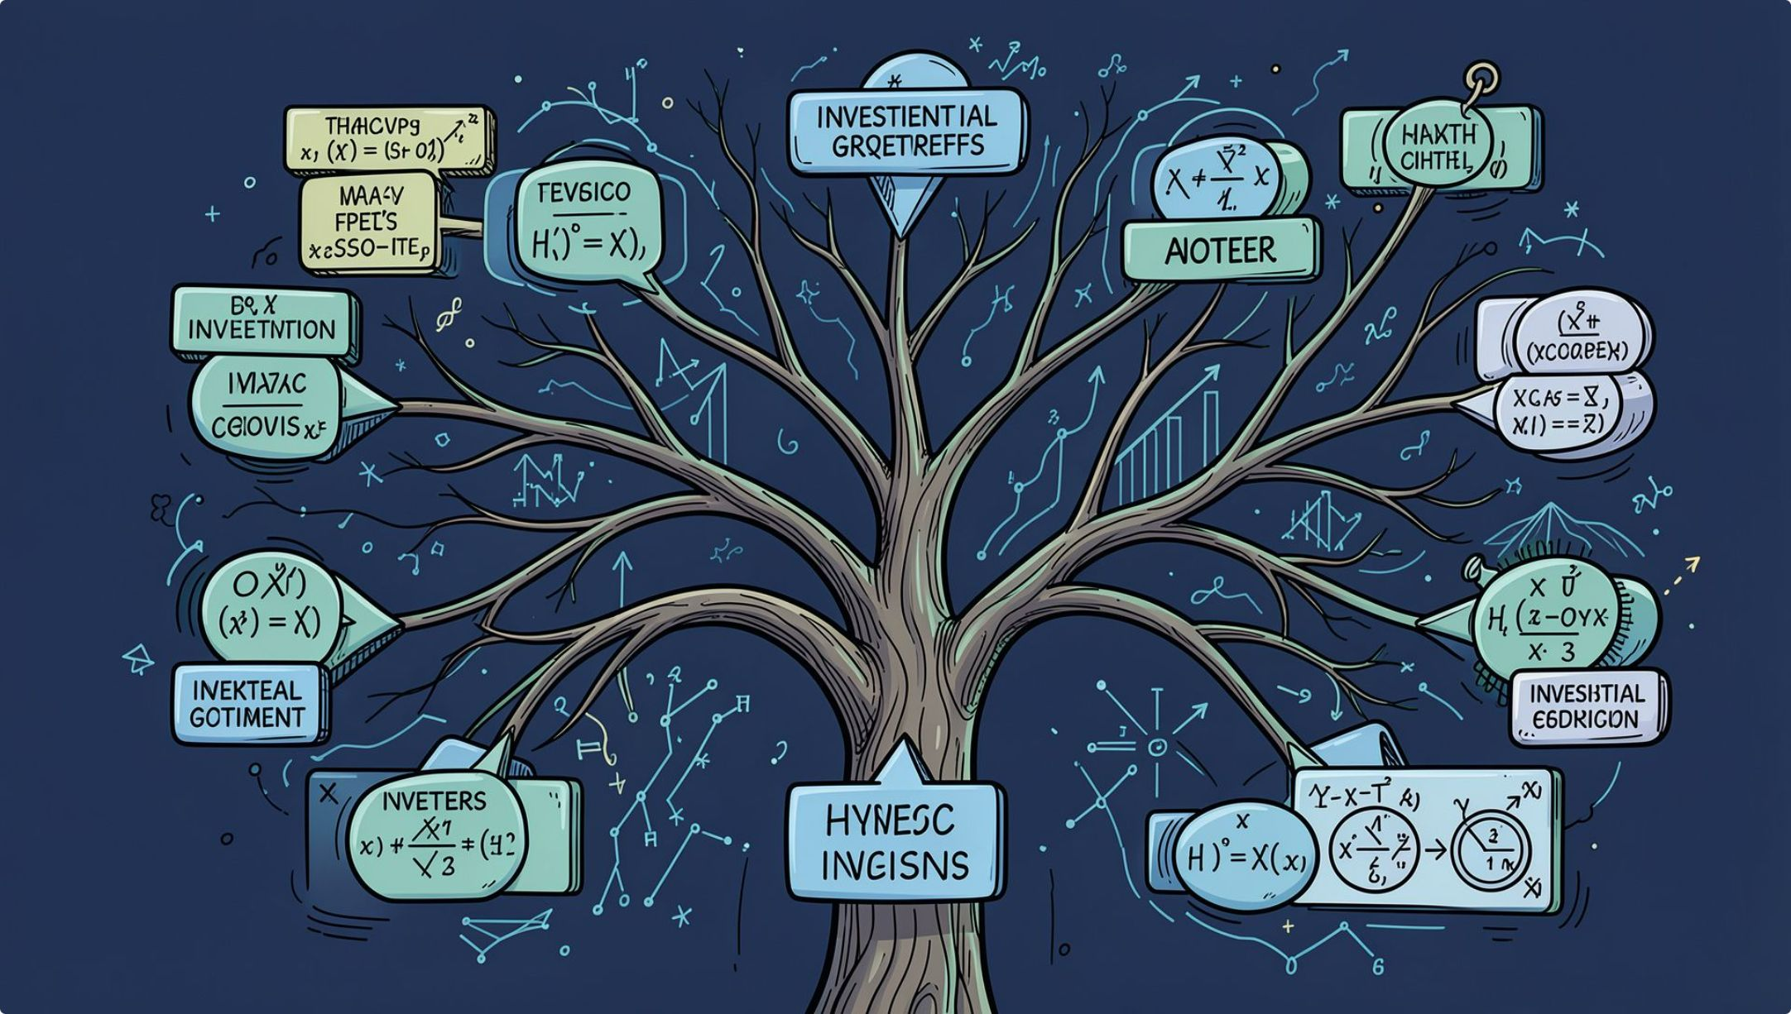


The Problem: Combinatorial Explosion
Asset Selection
A fund selects B assets from N candidates. The number of possible portfolios grows exponentially:
For , the combinations are already astronomically large.
Real-World Constraints
Max/min investment per asset
Sector limits, risk limits, liquidity
Regulatory requirements, transaction costs
Asset correlations, expected returns

Slide 4
Classical Methods — The Landscape
Classical portfolio optimization is mature and effective — but large discrete decisions and multiple constraints create rapidly growing computational costs.
Method | What it does | Main limitation
Markowitz MVO | Balances return vs. variance | Sensitive to estimation errors
Black-Litterman | Market equilibrium + investor views | Heavy on assumptions
CVaR Optimization | Controls tail risk | Expensive with many scenarios
MILP / MIP | Handles discrete decisions | Scales poorly with problem size
Genetic / Simulated Annealing | Heuristic search | No global optimum guarantee

Slide 5
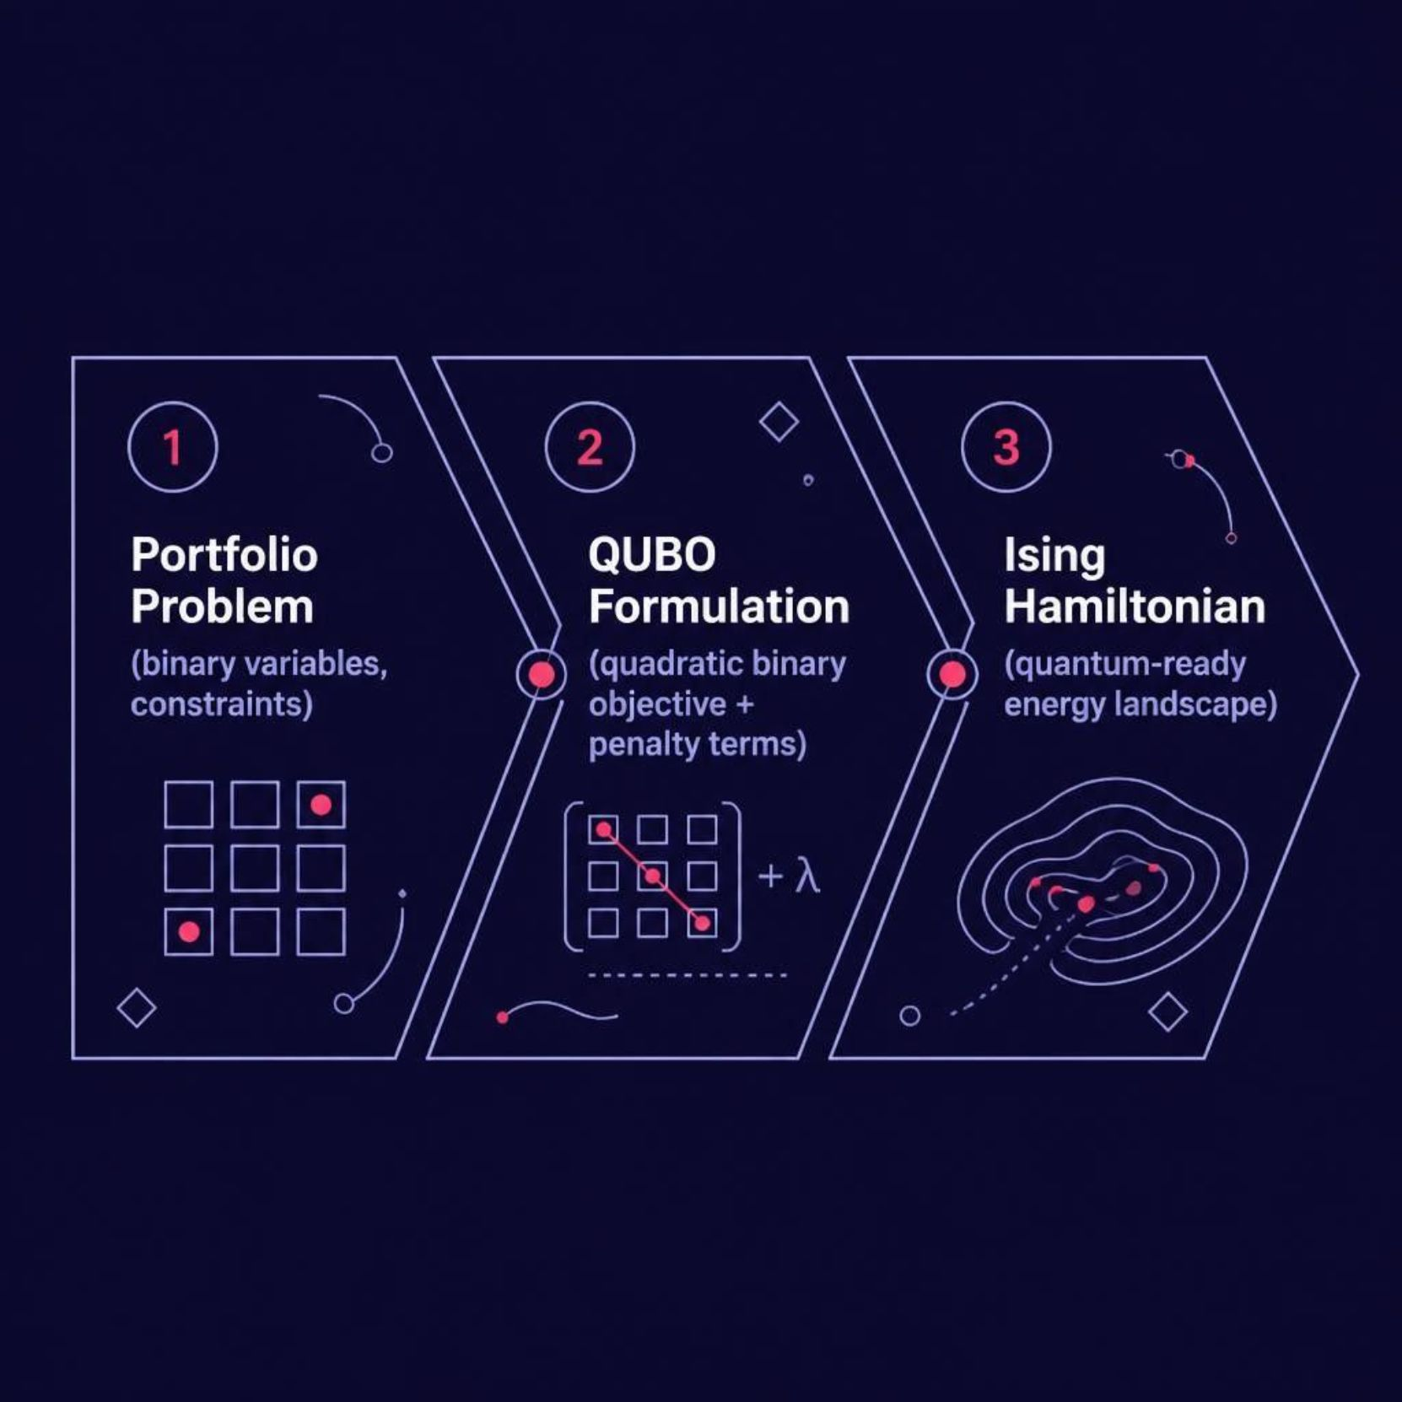

The Quantum Opportunity: QUBO Formulation
Why QUBO?
The problem naturally maps to Quadratic Unconstrained Binary Optimization — a form directly attackable by quantum algorithms.
The penalty term enforces exact asset count.

Slide 6






QAOA — Quantum Approximate Optimization Algorithm
Market Data
Financial Model
QUBO / Ising
NSE / USE / Tanzania
Returns, Covariance, Risk
Encode as Hamiltonian
QAOA Circuit
Portfolio Output
Parameterized quantum search
Candidate asset selection
QAOA is designed to approximately solve combinatorial problems by encoding the objective into a cost Hamiltonian and searching for low-energy solutions.

Slide 7
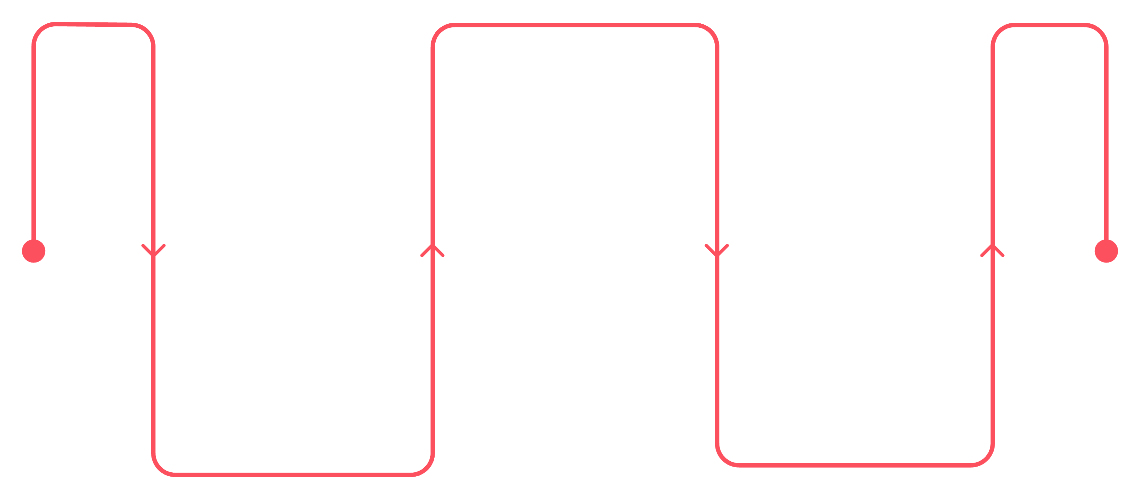
Hybrid Quantum-Classical Architecture
Quantum Core
Formulate QUBO and run QAOA to search asset combinations
Classical Pre-processing
Classical Post-processing
Collect NSE/USE/Tanzania data, compute returns, covariance, set constraints
Compute Sharpe, CVaR, volatility, benchmark and deliver candidates
This architecture is realistic for today's quantum hardware — classical systems handle data preparation and evaluation, while quantum search explores promising asset combinations.

Slide 8

The Experiment: Benchmarking Framework
Problem Sizes
Comparison Metrics
Metric | Classical | Quantum
Return, Volatility, Sharpe | ✓ | ✓
CVaR, Constraints | ✓ | ✓
Runtime, Scaling | ✓ | ✓
Energy cost, Reproducibility | ✓ | ✓
Small
Medium
N = 10
N = 20
Large
N = 30–100
Key question: At what problem size does the quantum/hybrid method become competitive?

Slide 9

SDG Impact — Beyond Finance
SDG 8 — Economic Growth
Better capital allocation → stronger institutions → productive business investment
Stronger pension/SACCO systems improve financial security and reduce inequalities
Quantum tech applied to African financial infrastructure; researchers + institutions + policymakers

Slide 10

Project Architecture & Final Hypothesis
Market Data
Data Processing
Financial Model
Classical & Quantum
Core Novelty
Hypothesis H₁
A quantum-hybrid portfolio optimization framework designed specifically for East African pension and SACCO problems, using regional market data and realistic constraints.
Quantum/hybrid optimization can produce portfolio solutions of comparable quality to strong classical baselines, with potential for improved scalability as problem complexity increases.

